Slide 1
Deploying CAs

Slide 2
Summary
To use certificates in your Active Directory Domain Services (AD DS) infrastructure, you have to use externally provided certificates or deploy and configure at least one CA.
The first CA that you deploy is a root CA. After you install the root CA, you can install a subordinate CA to apply policy restrictions and issue certificates. You also can use a CAPolicy.inf file to automate root CA installations and to provide additional configuration settings that are not available with standard GUI-based installations

Slide 3
What is AD CS?
AD CS is an identity technology in Windows Server 2016 that allows you to implement PKI so that you can easily issue and manage certificates to meet your organization's requirements.
Overview of PKI
PKI is the combination of software, encryption technologies, processes, and services that enables an organization to secure its communications and business transactions. PKI relies on the exchange of digital certificates between authenticated users and trusted resources. You use certificates to secure data and to manage identification credentials from users and computers both within and outside of your organization.

Slide 4
What is AD CS?
You can design a PKI solution by using AD CS to meet the following security and technical requirements of your organization:
Confidentiality. PKI gives you the ability to encrypt stored and transmitted data. For example, you can use a PKI-enabled Encrypting File System (EFS) to encrypt and secure data. You also can maintain the Confidentiality of transmitted data on public networks by using PKI-enabled Internet Protocol security (IPsec).
Integrity. You can use certificates to sign data digitally. A digital signature will identify whether any data was modified while communicating information. For example, a digitally signed email message will ensure that the message’s content was not modified while in transit. Additionally, in a PKI, the issuing CA digitally signs certificates that are issued to users and computers, which proves the integrity of the issued certificates.
Authenticity. A PKI provides several authenticity mechanisms. Authentication data passes through hash algorithms such as Secure Hash Algorithm 2 (SHA-2) to produce a message digest. The message digest then is digitally signed by using the sender’s private key from the certificate to prove that the sender produced the message digest.
Nonrepudiation. When data is digitally signed with an author’s certificate, the digital signature provides both proof of the integrity of the signed data and proof of the data’s origin.
Availability. You can install multiple CAs in your CA hierarchy to issue certificates. If one CA is not available in a CA hierarchy, other CAs can continue to issue certificates.

Slide 5
What is AD CS?
The role services of the AD CS role in Windows Server 2016:
Certification Authority. The main purposes of CAs are to issue certificates, to revoke certificates, and to publish authority information access (AIA) and revocation information. When you install the first CA, it establishes the PKI in your organization. You can have one or more CAs in one network, but only one CA can be at the highest point in the CA hierarchy. The root CA is the CA at the highest point in the hierarchy. However, you can have more than one CA hierarchy, which allows you to have more than one root CA. After a root CA issues a certificate for itself, subordinate CAs that are lower in the hierarchy receive certificates from the root CA.
Certification Authority Web Enrollment. This component provides a method to issue and renew certificates for users, computers, and devices that are not joined to the domain, are not connected directly to the network, or are for users of operating systems other than Windows.
Online Responder. You can use this component to configure and manage Online Certificate Status Protocol (OCSP) validation and revocation checking. An Online Responder decodes revocation status requests for specific certificates, evaluates the status of those certificates, and returns a signed response that contains the requested certificate status information. The certificate revocation data can come from a CA on a computer that is running Windows Server 2003 or later.
Network Device Enrollment Service (NDES). With this component, routers, switches, and other network devices can obtain certificates from AD CS.

Slide 6
What is AD CS?
Certificate Enrollment Web Service (CES). This component works as a proxy client between a computer that is running Windows 7 or later and the CA. Windows Server 2008 R2 introduced this component, and it requires that the Active Directory forest is at least at the Windows Server 2008 R2 functional level. It enables users, computers, or applications to connect to a CA by using web services to:
Request, renew, and install issued certificates.
Retrieve certificate revocation lists (CRLs).
Download a root certificate.
Enroll over the Internet or across forests.
Renew certificates automatically computers that are part of untrusted AD DS domains or are not joined to a domain.
Certificate Enrollment Policy Web Service. This component enables users to obtain certificate enrollment policy information. Combined with CES, it enables policy-based certificate enrollment when the client computer is not a member of a domain or when a domain member is not connected to the domain.

Slide 7
Options for implementing CA hierarchies
CA hierarchy determines the core design of your internal PKI and determines the purpose of each CA in the hierarchy. Each CA hierarchy usually includes two or more CAs. Usually, the second CA and all others after that deploy with a specific purpose. Only the root CA is mandatory.
For smaller and simpler environments, you can have a CA hierarchy with just one deployed CA. This CA usually deploys as an enterprise root CA. Additionally, you may choose to not deploy an internal CA at all and use externally provided certificates.
If you decide to implement a CA hierarchy and have deployed a root CA already, you must decide which
roles to assign CAs on the second and third tiers. In general, we do not recommend building a CA hierarchy
deeper than three levels unless it is in a complex and distributed environment.
Most commonly, CA hierarchies have two levels, with the root CA at the top level and the subordinate
issuing CA on the second level. Usually, the root CA is taken offline while the subordinate CA issues and
manages certificates for all clients.

Slide 8
Options for implementing CA hierarchies
In general, CA hierarchies fall into one of following categories:
CA hierarchies with a policy CA. Policy CAs are types of subordinate CAs that are directly below the root CA in a CA hierarchy. You use policy CAs to issue CA certificates to subordinate CAs that are directly below the policy CA in the hierarchy. The role of a policy CA is to describe the policies and procedures that an organization implements to secure its PKI, the processes that validate the identity of certificate holders, and the processes that enforce the procedures that manage certificates. A policy CA issues certificates only to other CAs. The CAs that receive these certificates must uphold and enforcethe policies that the policy CA defined. Using policy CAs is not mandatory unless different divisions, sectors, or locations of your organization require different issuance policies and procedures. However, if your organization requires different issuance policies and procedures, you must add policy CAs to the hierarchy to define each unique policy. For example, an organization can implement one policy CA for all certificates that it issues internally to employees and another policy CA for all certificates that it issues to users who are not employees.
CA hierarchies with cross-certification trust. In this scenario, two independent CA hierarchies interoperate when a CA in one hierarchy issues a cross-certified CA certificate to a CA in another hierarchy. When you do this, you establish mutual trust between different CA hierarchies.
CAs with a two-tier hierarchy. In a two-tier hierarchy, there is a root CA and at least one subordinate CA. In this scenario, the subordinate CA is responsible for policies and for issuing certificates to requestors.

Slide 9
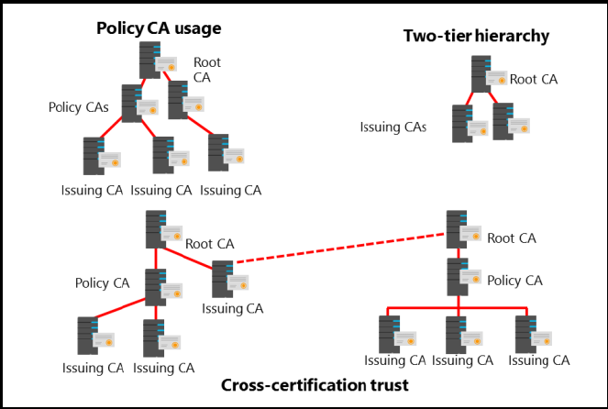
Options for implementing CA hierarchies

Slide 10
Standalone vs. enterprise CAs

Slide 11
Considerations for deploying a root CA

Slide 12
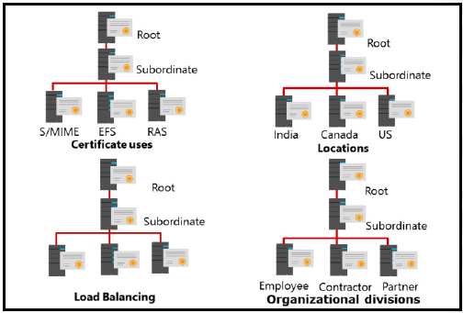
Considerations for deploying a subordinate CA

Slide 13
Considerations for deploying a subordinate CA
You can use a subordinate CA to implement policy restrictions for PKI and to issue certificates to clients. After installing a root CA for the organization, you can install one or more subordinate CAs.
When you use a subordinate CA to issue certificates to users or computers that have an account in an AD DS environment, you can install the subordinate CA as an enterprise CA. Then, you can use the data from the client accounts in AD DS to issue and manage certificates and to publish certificates to AD DS. To complete this procedure, however, you must be a member of the local Administrators group or have equivalent permissions. If the subordinate CA is an enterprise CA, you also need to be a member of the Domain Admins group or have equivalent permissions.
From a security perspective, a recommended scenario would be to have an offline, standalone root CA and an enterprise subordinate CA.

Slide 14
Considerations for deploying a subordinate CA
A subordinate CA usually deploys to achieve some of the following functionalities:
Usage. You can issue certificates for a number of purposes, such as Secure/Multipurpose Internet Mail Extensions (S/MIME), EFS, or remote access. The issuing policy for these different uses might be distinct, and separation provides a basis for administering these policies.
Organizational divisions. You might have different policies for issuing certificates that depend on an entity’s role in the organization. You can create subordinate CAs to separate and administer these policies.
Geographic divisions. Organizations often have entities at multiple physical sites. Limited network connectivity between these sites might necessitate individual subordinate CAs for many or all sites.
Load balancing. If you use your PKI to issue and manage a large number of certificates and have only one CA, it can result in considerable network load for that single CA. Using multiple subordinate CAs to issue the same kind of certificates divides the network load between CAs.
Backup and fault tolerance. Multiple CAs increase the possibility that your network has operational CAs available to respond to user requests.

Slide 15
How to use the CAPolicy.inf file for installing a CA
You can use the CAPolicy.inf file if you want to deploy a root or subordinate CA and you want to define some values and parameters during or after installation. The CAPolicy.inf file is a plain text file that contains various settings that you can use when you install the AD CS role or when you renew the CA certificate. The CAPolicy.inf file is not required to install AD CS, but without it, default settings are applied. In many cases, the default settings are insufficient for more complex deployments. You can use the CAPolicy.inf file to configure CAs in more complex deployments.
Each CAPolicy.inf file is divided into sections and has a simple structure, described as follows:
A section is an area in the .inf file that contains a logical group of keys. A section always appears in brackets in the .inf file.
A key is the parameter that is to the left of the equal (=) sign.
A value is the parameter that is to the right of the equal (=) sign.

Slide 16
How to use the CAPolicy.inf file for installing a CA
For example, if you want to specify an AIA point in the CAPolicy.inf file, you will use following syntax:
[AuthorityInformationAccess]
URL=http://pki.adatum.com/CertData/adatumCA.crt
In this example, AuthorityInformationAccess is a section, URL is the key, and http://pki.adatum.com/CertData/adatumCA.crt is the value. You also can specify some CA server settings in the CAPolicy.inf file. One example of the section that specifies these settings is:
[certsrv_server]
RenewalKeyLength=2048
RenewalValidityPeriod=Years
RenewalValidityPeriodUnits=5
CRLPeriod=Days
CRLPeriodUnits=2
CRLDeltaPeriod=Hours
CRLDeltaPeriodUnits=4
ClockSkewMinutes=20
LoadDefaultTemplates=True
AlternateSignatureAlgorithm=0
ForceUTF8=0
EnableKeyCounting=0

Slide 17
How to use the CAPolicy.inf file for installing a CA
You can also use the CAPolicy.inf file when installing AD CS to define the following:
Certification practice statement. This describes the practices that the CA uses to issue certificates. This includes the types of certificates issued, information about issuing, renewing, and recovering certificates, and other details about the CA’s configuration.
Object identifier. This identifies a specific object or attribute.
CRL publication intervals. This defines the interval between publications for the base CRL.
CA renewal settings. You can define renewal settings as follows:
Key size. This defines the length of the key pair that is used during a root CA renewal.
Certificate validity period. This defines the validity period for a root CA certificate.
CDP and AIA paths. This provides the path for root CA installations and renewals.
After creating your CAPolicy.inf file, you must copy it to the %SystemRoot% folder of your server (for example, C:\Windows) before you install the AD CS role or before you renew the CA certificate.
Notes:
Note: The CAPolicy.inf file is processed for both root and subordinate CA installations and
renewals.

